Slide 1
GOMUKU GAME SYSTEM
SOEN 6431 PROJECT PRESENTATION
Presented By :
Ananya Varsha,
Dejian Wang,
Guoxue Yang,
Haochen Zou,
Vishanth Suresh

Slide 2
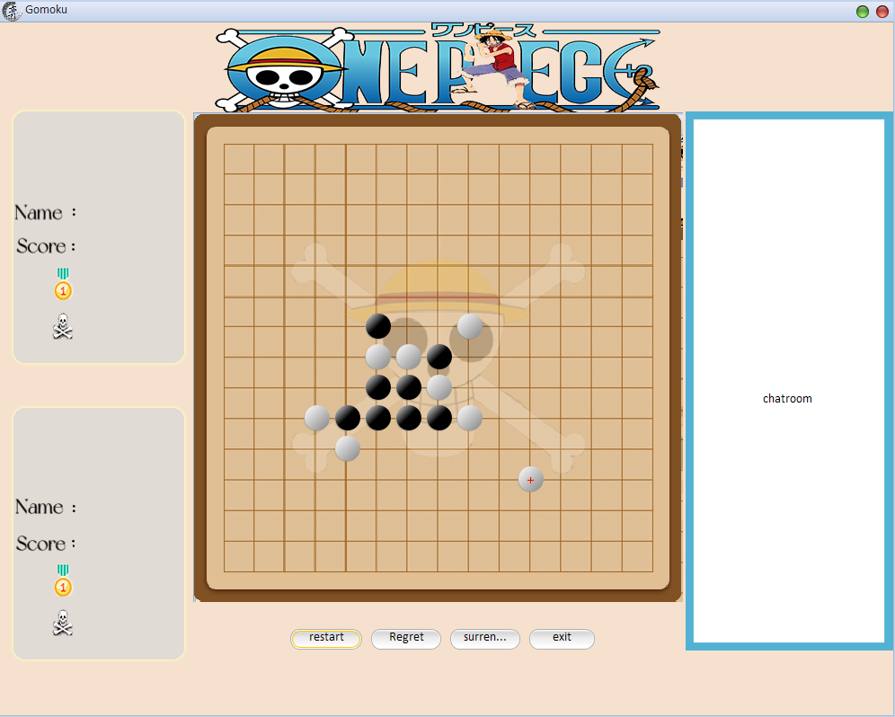
Introduction: What is the Gomuku Game
Gomoku, also called Five in a Row, is an abstract strategy board game [1].
It is traditionally played with Go pieces (black and white stones) on a Go board.
It is played using a 15×15 board while in the past, a 19×19 board was standard.
Because pieces are typically not moved or removed from the board, Gomoku may also be played as a paper-and-pencil game.
The game is known in several countries under different names.​

Slide 3
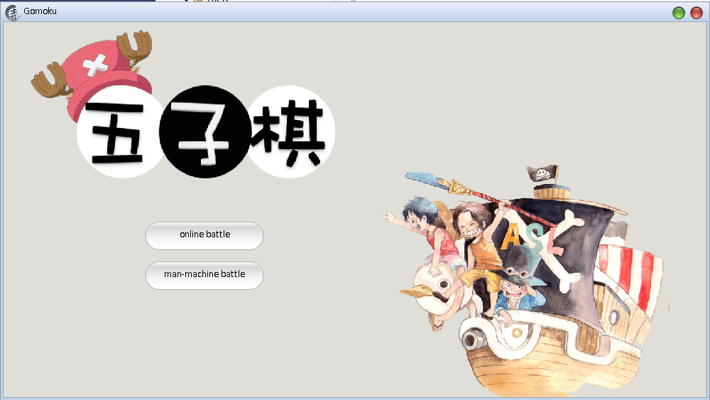
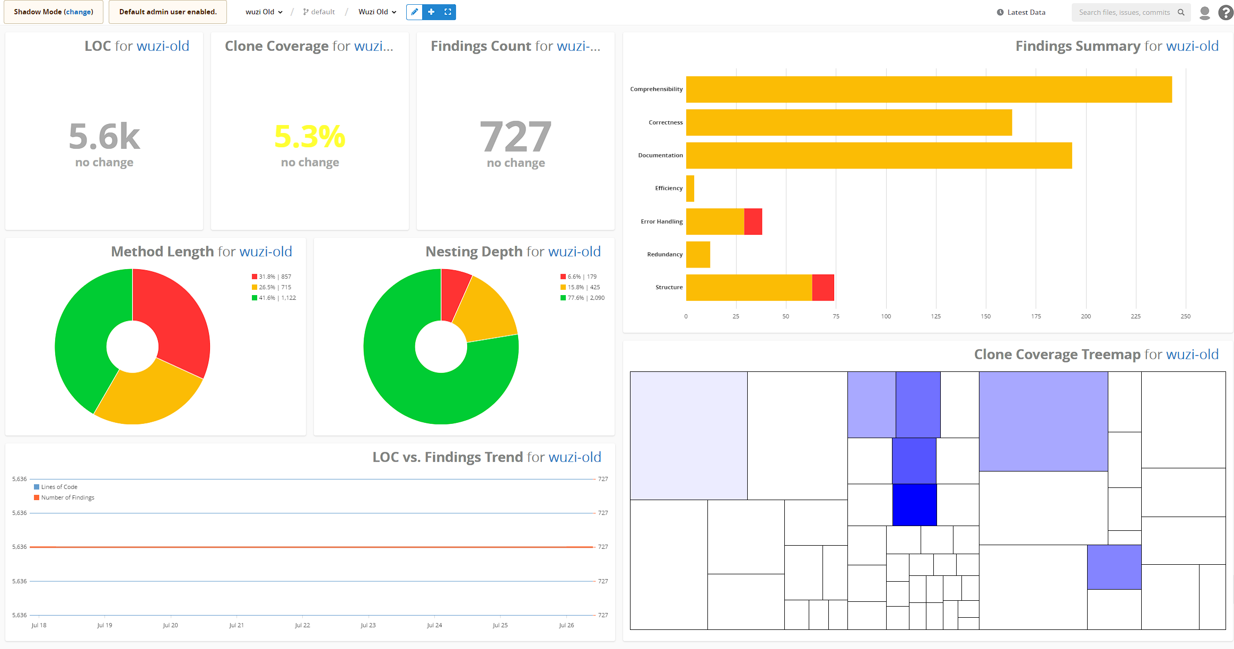
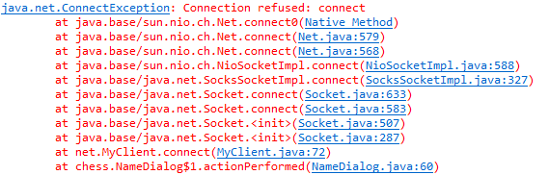
Problem Description
The Gomoku game system is a legacy system which exists with an outdated tech stack.​
There are 727 undesirables found in the project system.​
The system contains the network component but is not runnable.​
The system structure is complicated.​​
All comments are written in mandarin and need language localization.​
Limited capability to change.

Slide 4

How and What We Work for Project Maintenance
We classify the undesirables into four parts: Comprehensive, Correctness, Documentation, and Structure.​
We do team discussions each week and peer review the changed source code.​
The hard version control method is implemented utilized the agile development approach.​
Apply documentation and maintenance procedures at the same time.
Clear role division.
Mainly employed reengineering treatments: code reconstructing, dispensable, and manual undesirables handling。

Slide 5
Challenges: What We Have Done or Not
Structure problems, such as long method and deeply nested loop.​
If fixing the undesirables will pop up more undesirables anyway, the target code will be reversed to the beginning.​
Some UI rendering pipelines and AI decision trees should not be changed, otherwise will cause potential risk and lower cohesion and readability.​
The defects detect tool creates false positive findings.​
TeamScale sometimes is too sensitive which deviates the user’s focus on healthy code(but diagnose as a defect) ​
Limited Capability to Fix.​
some technical stack is too old, and users need more time and effort to learn.

Slide 6

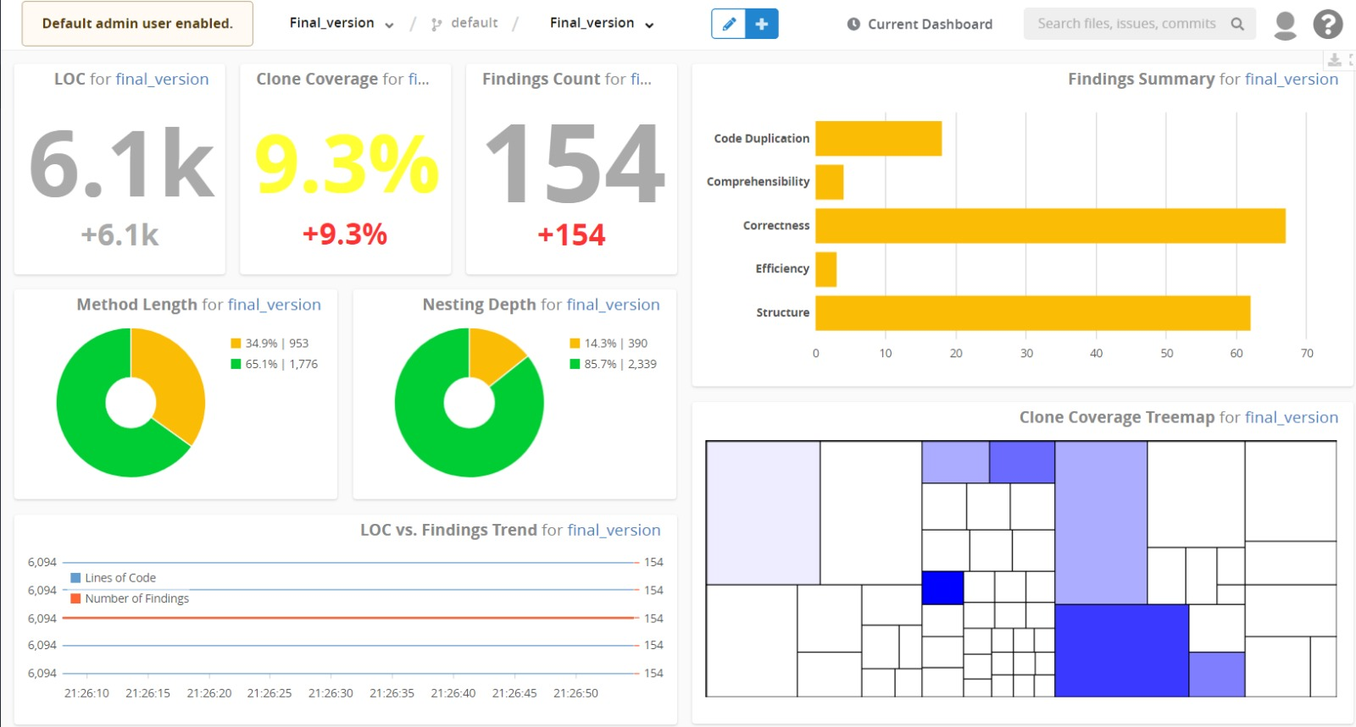
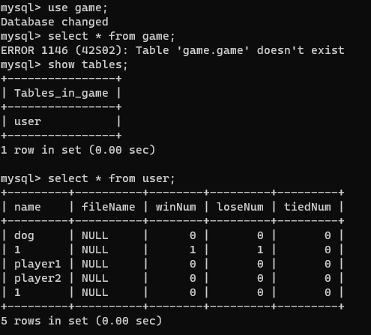
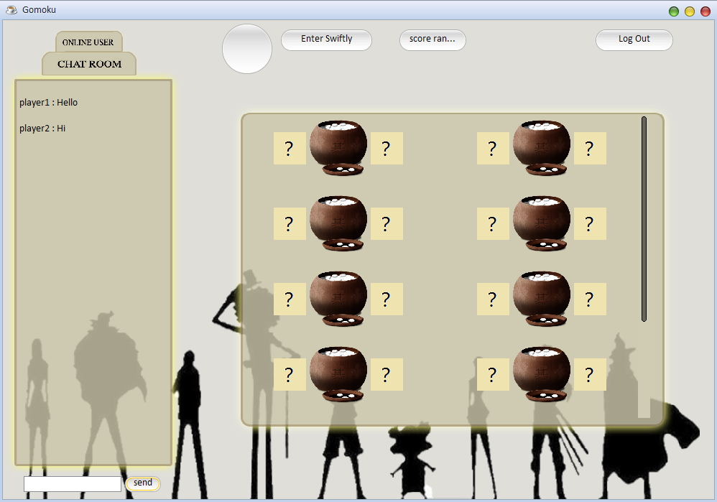
Result Display
Desirables fixing​: we lower the undesirables from 727 to 154 at the end.​
No fatal/severe structure problem exists.​
Network component functional again.​
Fix the JDBC and JavaWeb modules.​
Fix MySQL database.​
Localization​: Mandarin to English​

Slide 7
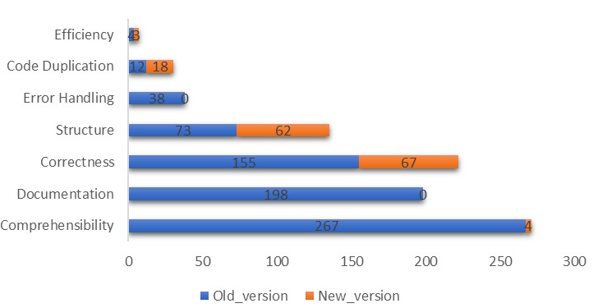
Conclusion
Comparison between old version & new version:

Slide 8
Future Works
Code Clone​
Because UI renders many buttons, and each one of them is independent. Combining them by force will increase the difficulty of maintainability in the future.​
The system structure is not 100% flexible​
Not implementing the strategy pattern for AI decision making, so only one level of difficulty.​
Mediocre gameplay experience (non-technical problem)​
UI doesn’t have a sense of design, like a chess game.​

Slide 9
What We Have Learnt
Team Cooperation
Communication Skills
Software Quality Improvement Techniques
Project Management
Risk Analysis by Modifying Code
Software Maintainability
Notes:
Project time management

Slide 10
References
[1] Wikimedia Foundation. (2022, June 22). Gomoku. Wikipedia. Retrieved July 22, 2022, from https://en.wikipedia.org/wiki/Gomoku ​

Slide 11
Thanks!
Any questions?

